Slide 1
10 Kentucky Education Statistics Every Board Member Should Know
KSBA Winter Symposium
December 3, 2021
Kimber L. Fender
Campbell County Board of Education
Aaron Butler
Kentucky Department of Education

Slide 2
Roughly 6 of every 7 school aged children in Kentucky attends a K-12 public school.
647,987
public school students
70,009
private school students
23,008
homeschool students
Sources: School Report Card, 2021; NCES, 2015; KDE Fast Facts, 2021

Slide 3
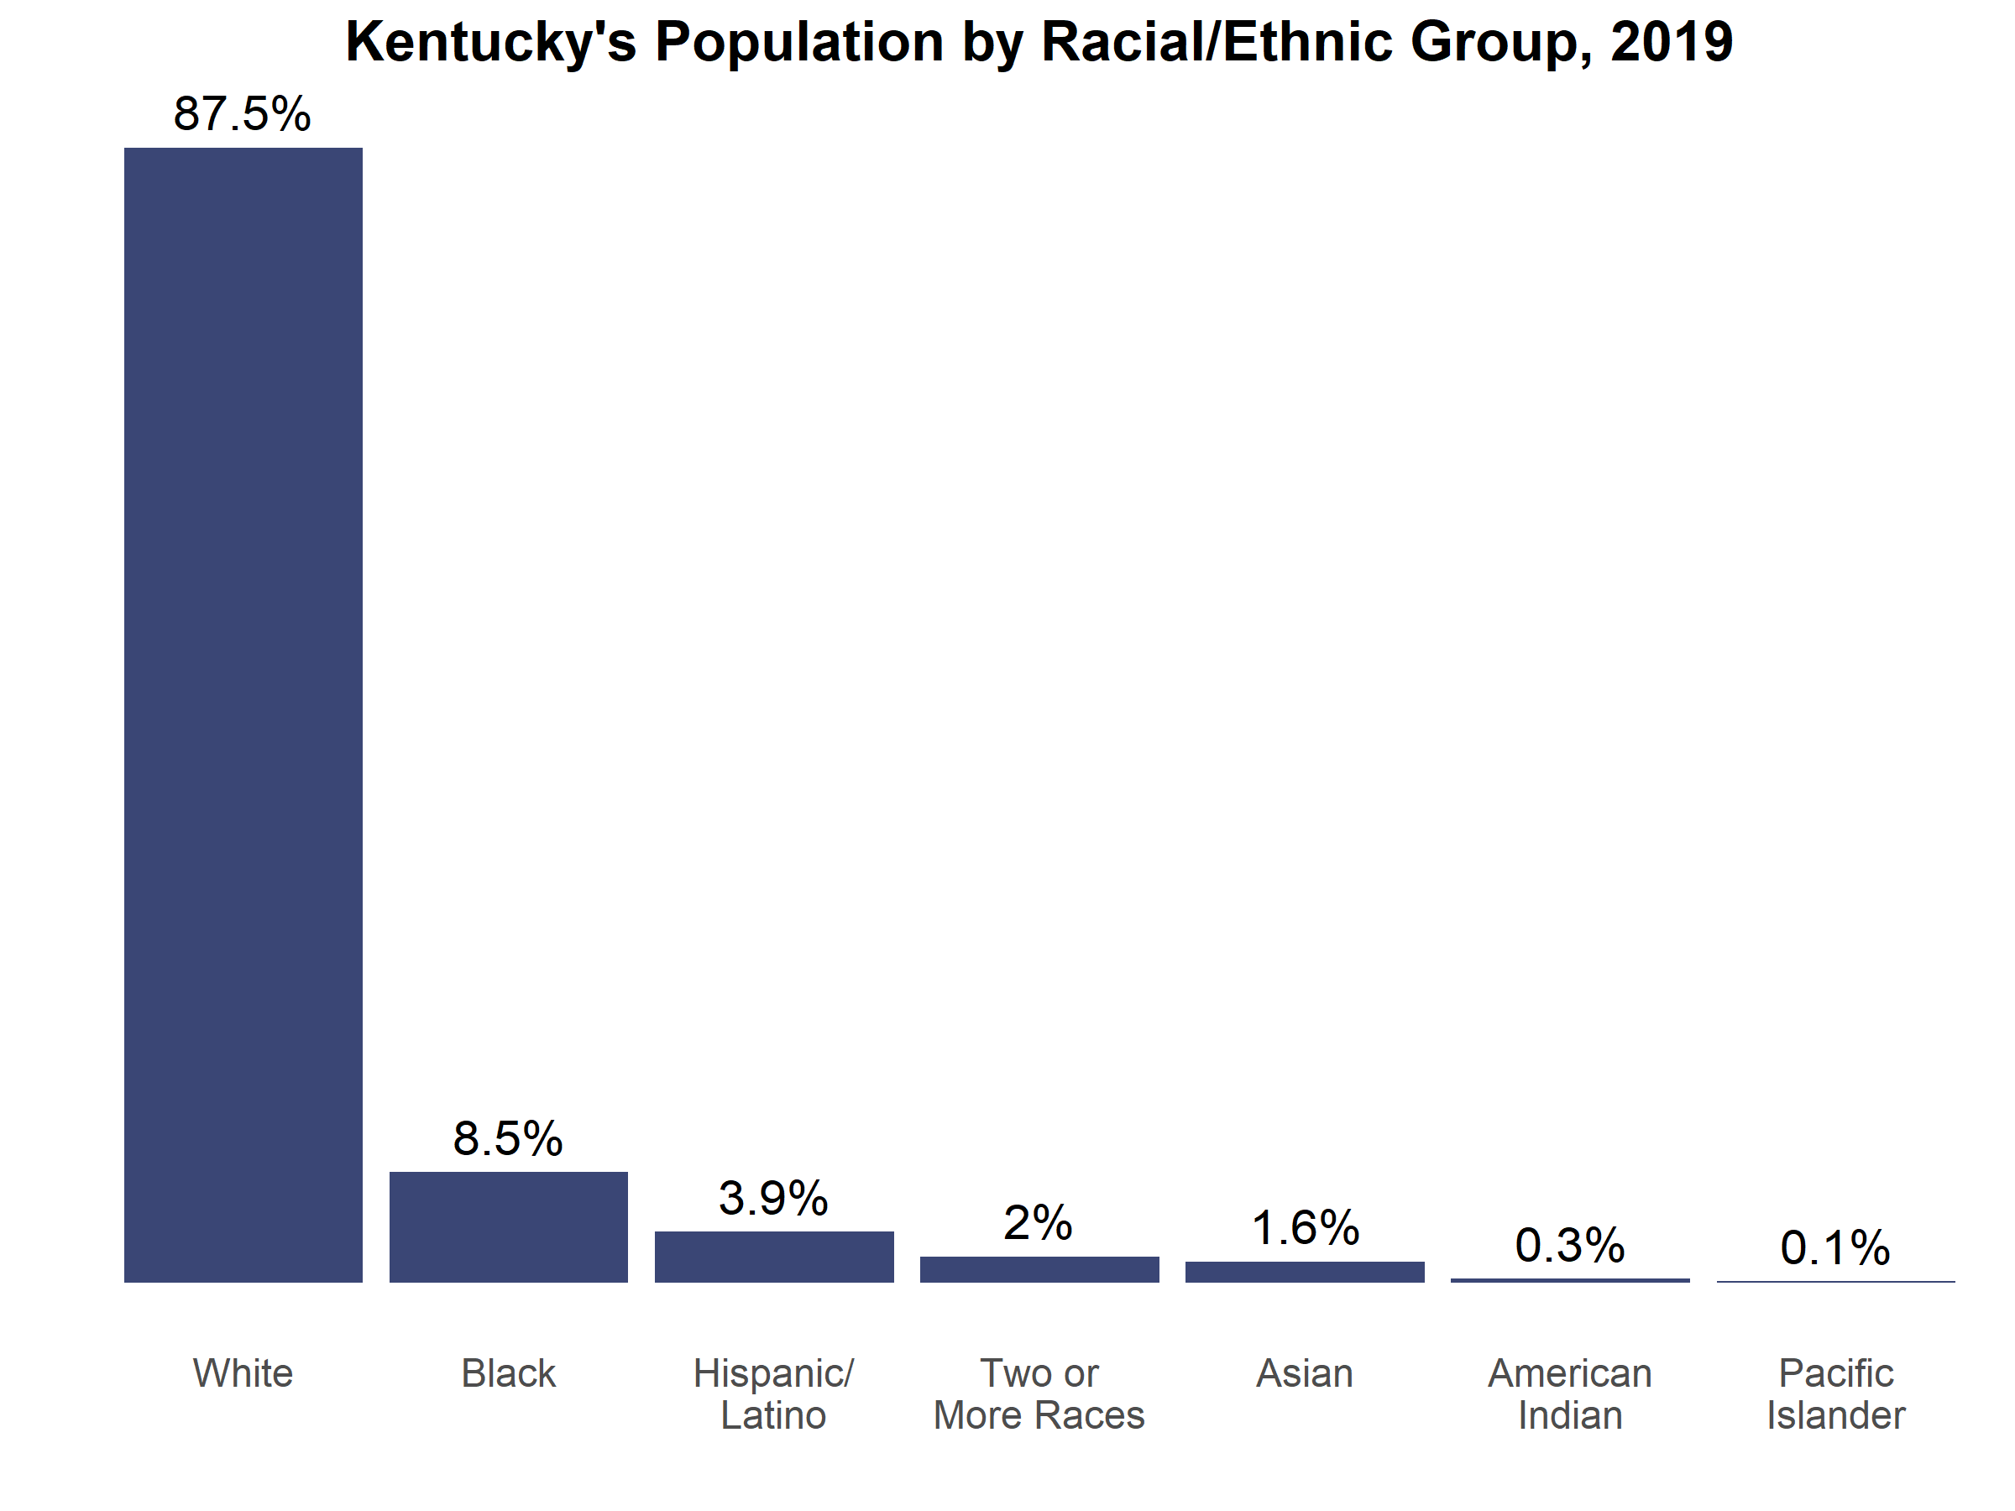
Majority of Kentuckians identify as white.
Source: US Census, 2019

Slide 4
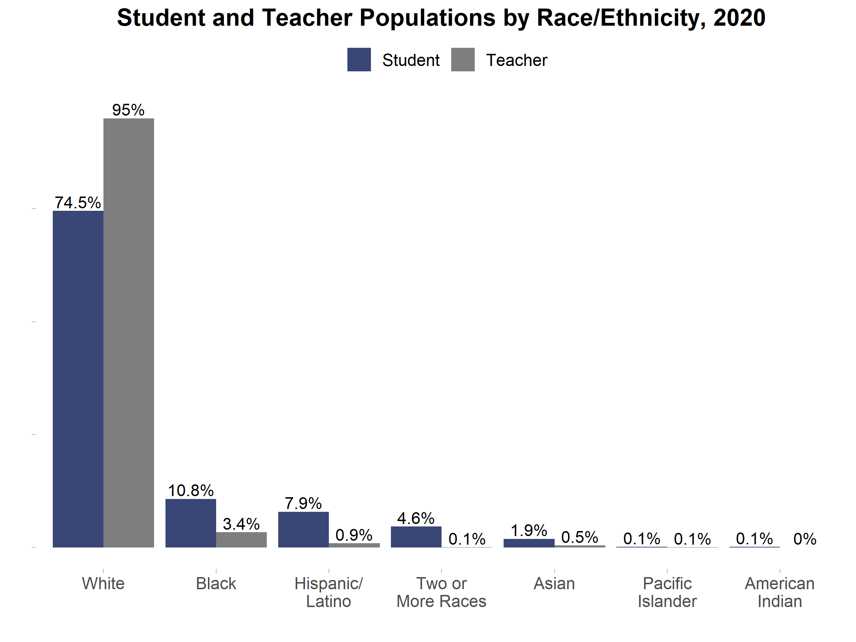
Students of color represent 26% of the state's public-school population, whereas teachers of color make up only 5% of the educator workforce.
Source: School Report Card, 2021

Slide 5
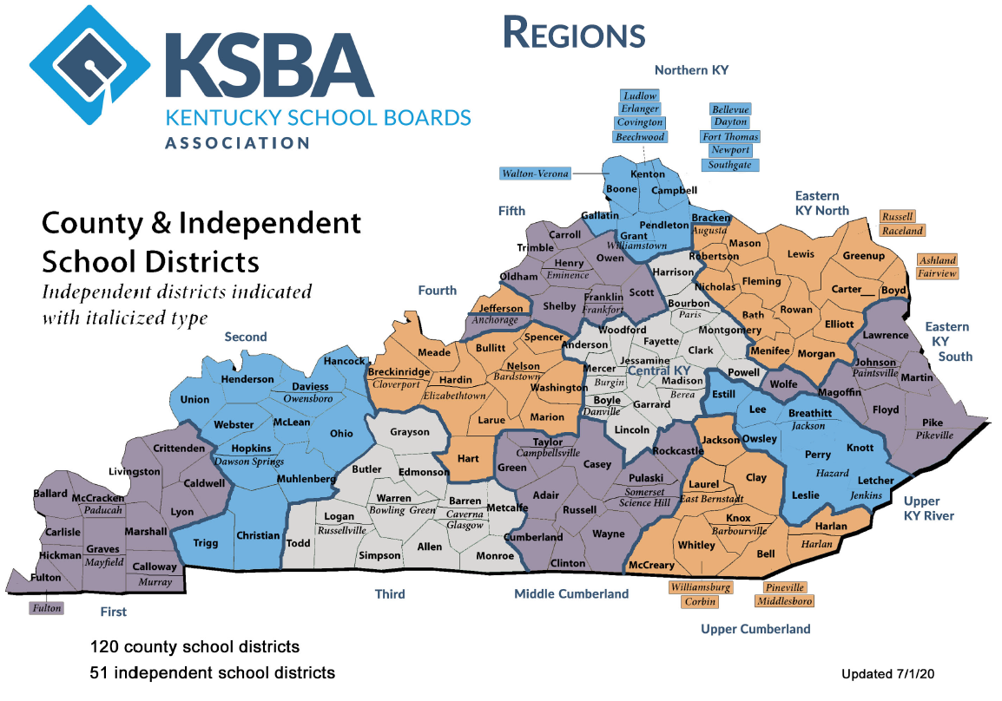
Kentucky has 120 county school districts and 51 independent school districts, overseeing 1,477 school buildings.
Sources: KSBA, 2020; School Report Card, 2021

Slide 6
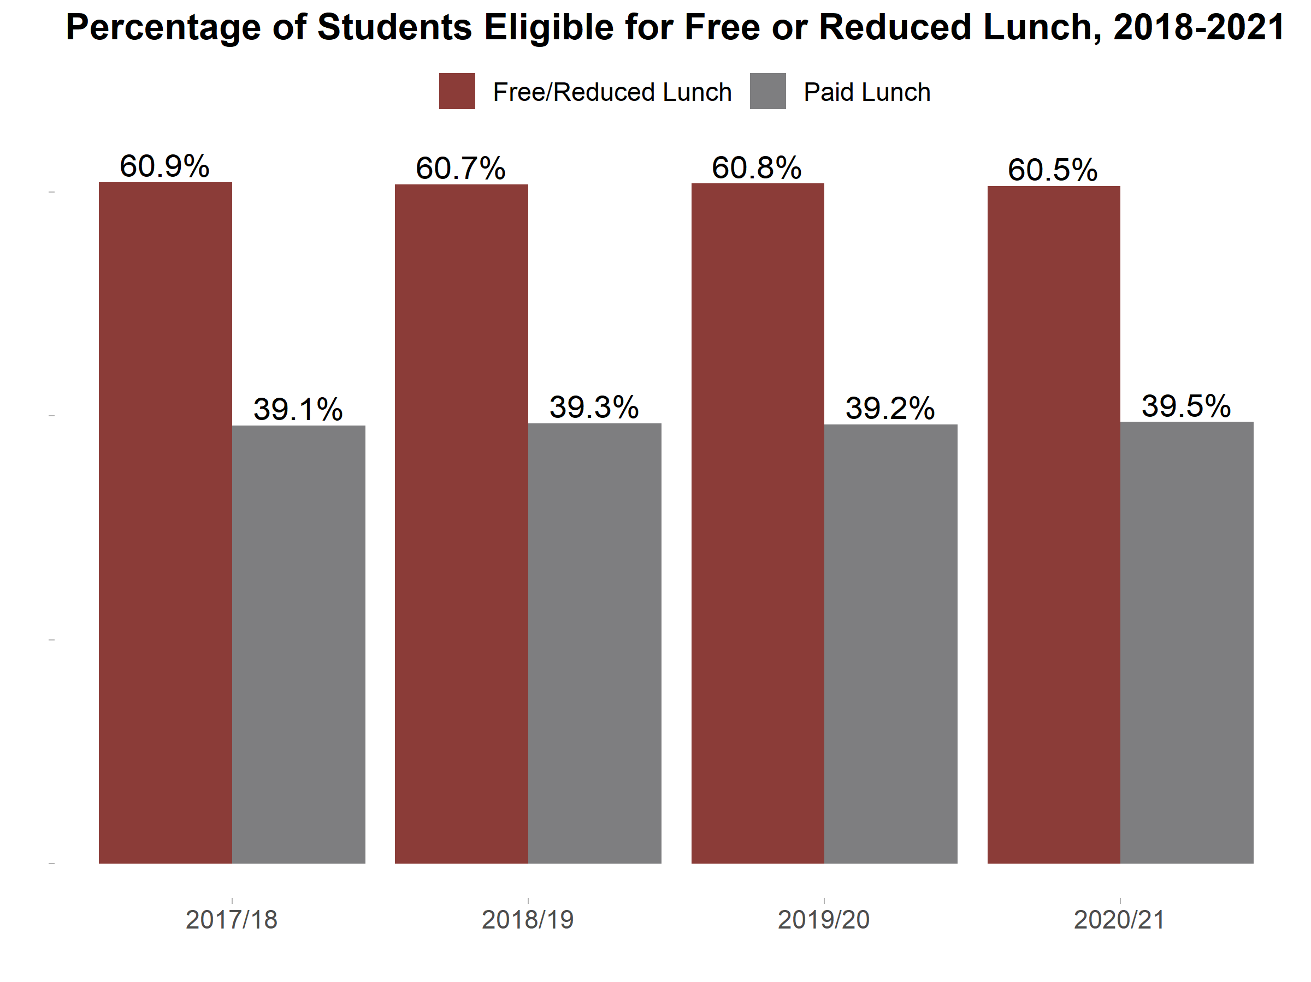
386,362 (or 61%) of public-school students are eligible for the federal free or reduced lunch program.
Students eligible for free or reduced lunch program
Source: School Report Card, 2021

Slide 7
While 15,733 children are enrolled in Head Start, there are roughly 50,000 children who are eligible but do not take advantage of the program.
~110,000 3- and 4-year-olds in Kentucky
67,100 | FRPL students
(15,733) | Enrolled in Head Start
51,367 | Potential Head Start students
Source: School Report Card, 2021

Slide 8
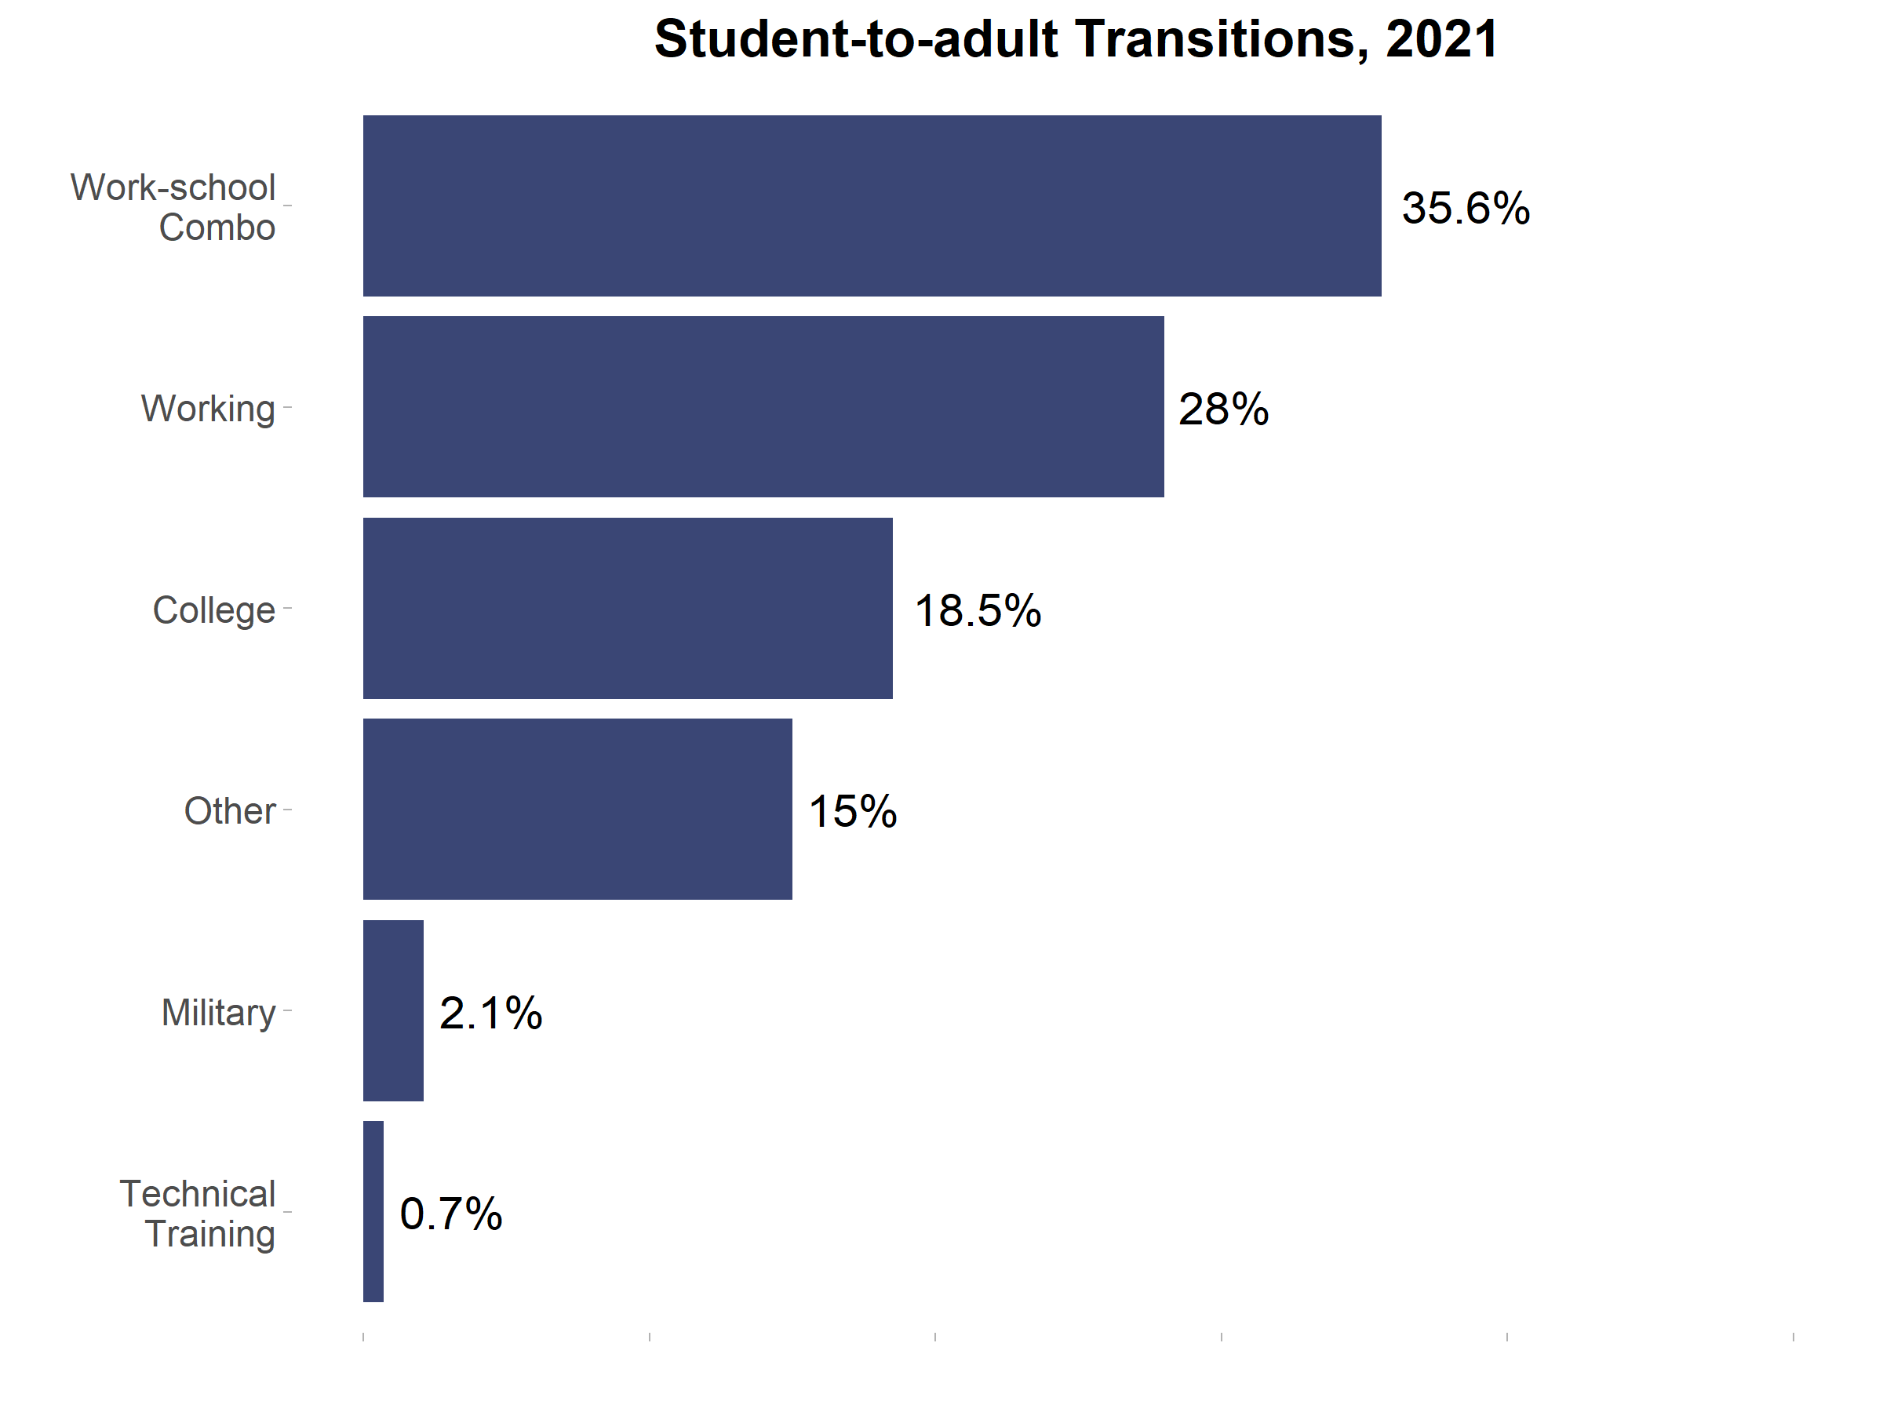
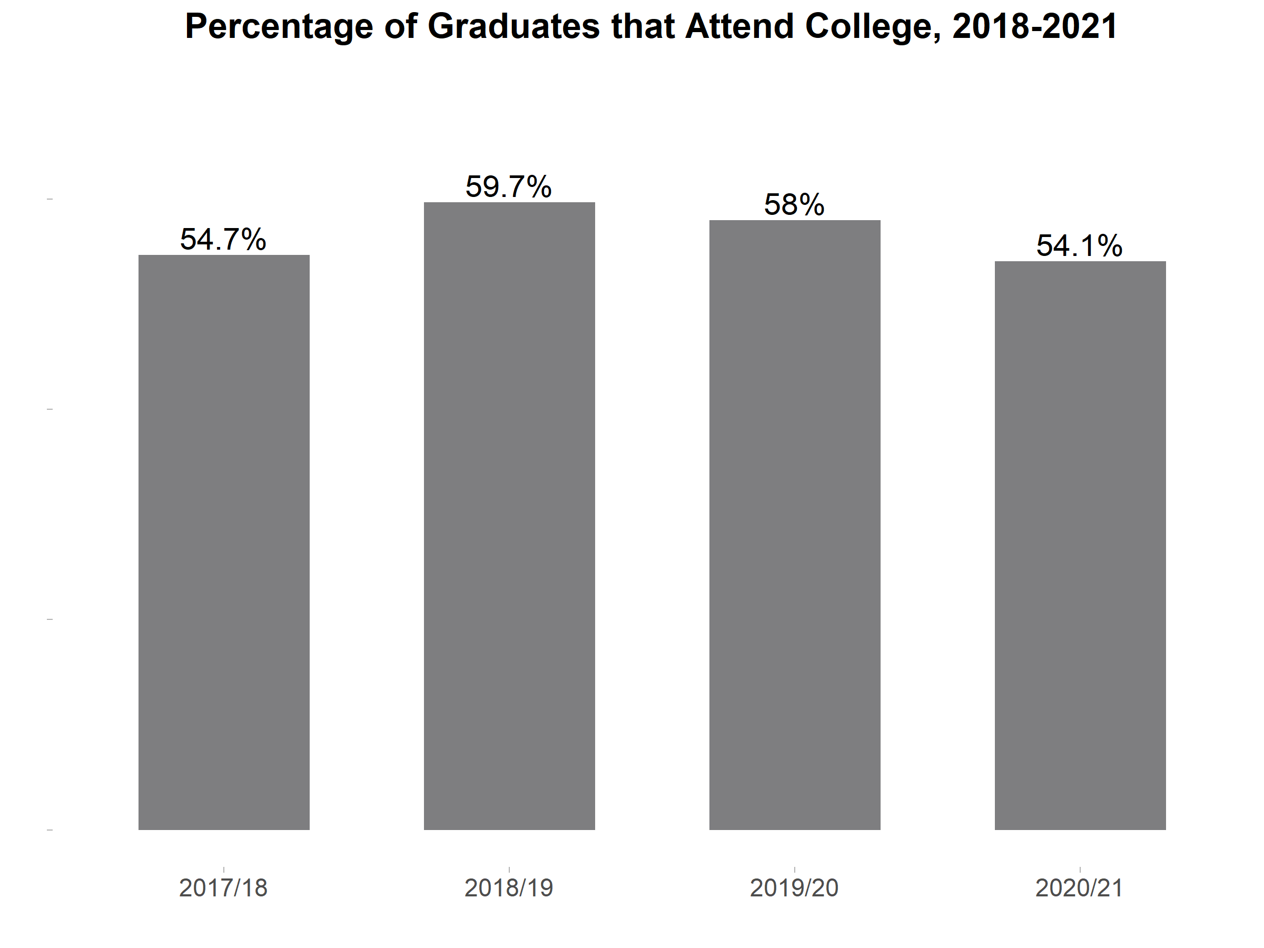
1 in 2 Kentucky graduates go on to attend college or university.
Source: School Report Card, 2021

Slide 9
Statistics vary regarding internet access - between 73% and 98% of Kentucky students have Internet access beyond the school campus.
94% of households have broadband capabilities (Federal Communications Commissions, 2021)
78% of households with internet access (includes cell phone providers) (NCES, 2016)
98% of students with internet access at home (includes cell phone providers) (KDE, 2021)
73% of families reported having reliable internet at home (KDE, 2021)

Slide 10
Majority of districts offer full-day kindergarten.
163 districts offer full-day kindergarten
2 districts offer half-day kindergarten
6 districts offer both full- and half-day kindergarten
Source: School Report Card, 2021

Slide 11
There is a $23 million difference between SEEK and local funds.
$2,973,696,700 in SEEK funding
$2,950,117,448 in local funding
Source: School Report Card, 2021

Slide 12
Kentucky spends $14,331 on average for each public-school student.
Top 5 Districts in Total Per-pupil Spending
Southgate Independent | $25,323
Anchorage Independent | $22,878
Martin County | $21,392
Menifee County | $20,965
Newport Independent | $20,781
Bottom 5 Districts in Total Per-pupil Spending
Hopkins County | $11,814
Butler County | $11,775
Madison County | $11,522
Caldwell County | $11,513
Ohio County | $11,222
Source: School Report Card, 2020

Slide 13
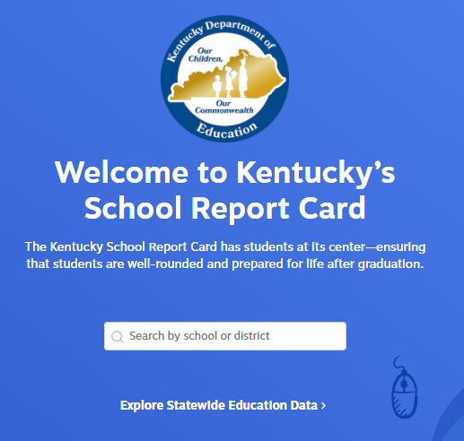
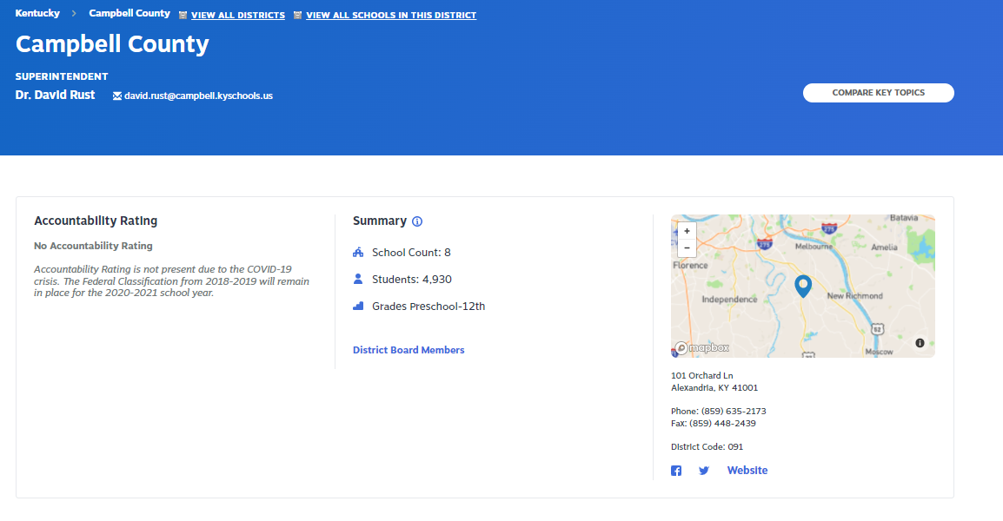
We encourage you to explore your own data.
Search by your district.
https://www.kyschoolreportcard.com/

Slide 14
Thank you!
Kimber Fender
kimber.fender@campbell.kyschools.us
Aaron Butler
aaron.butler@education.ky.gov

